Slide 1

ENGG404 – Lecture Chapter 7.5: Organizational Design and Evolution of Approaches to Safety
Fundamentals of RM
RM System and Process
Leadership in RM
Incident Investigation
RM Tools & Challenges
RM in Industry
People & Org.
Application and Perspectives
On Becoming a Leader in Risk Management

Slide 2
Learning Outcomes:
Differentiate and explain the terms vision, values, guiding principles, mission statement, and policies.
Explain how any organization can be modelled.
Explain the relationship between the culture of the organization and the (safety) performance of organizations.
Explain how good characteristics of managers / leaders can positively influence the culture of an organization.
Chapter 7.5: Organizational Design
2

Slide 3
Line Management – A Simplistic Depiction of The U of Alberta:
The line is evident …
Board of Governors
President
Deans
Department Chairs & School Directors
Professors
Chapter 7.5: Organizational Design
3

Slide 4
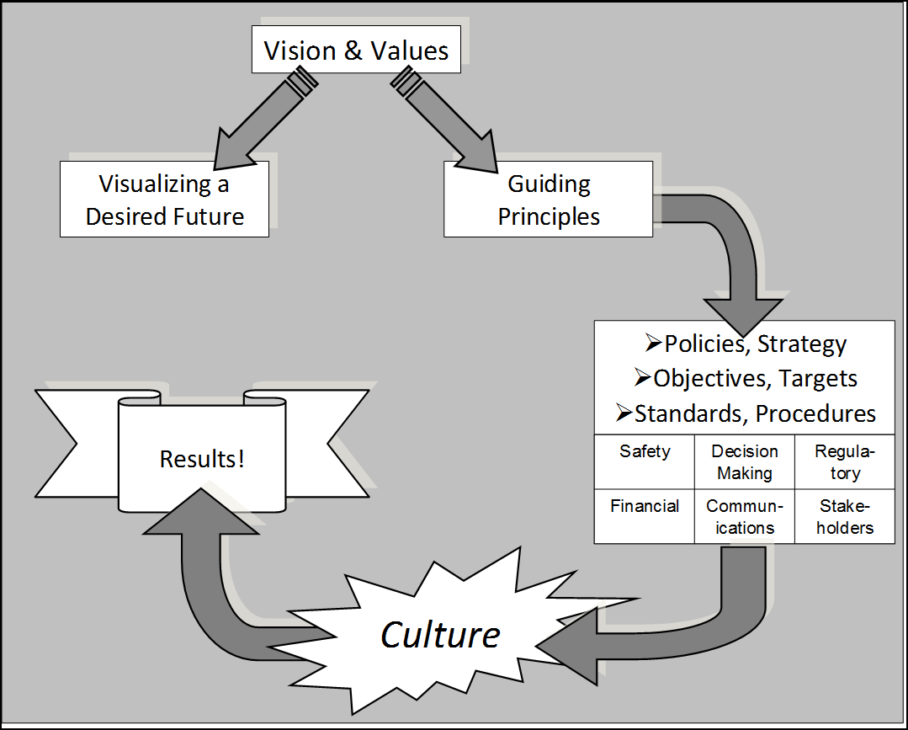
Corporate Mechanisms and Supporting Documents
Leading organizations document their aspirations in their “Vision & Values” statements (Vision Statement, Mission Statement, Code of Ethics, Corporate slogans, etc.)
Mission Statement
Chapter 7.5: Organizational Design
4

Slide 5
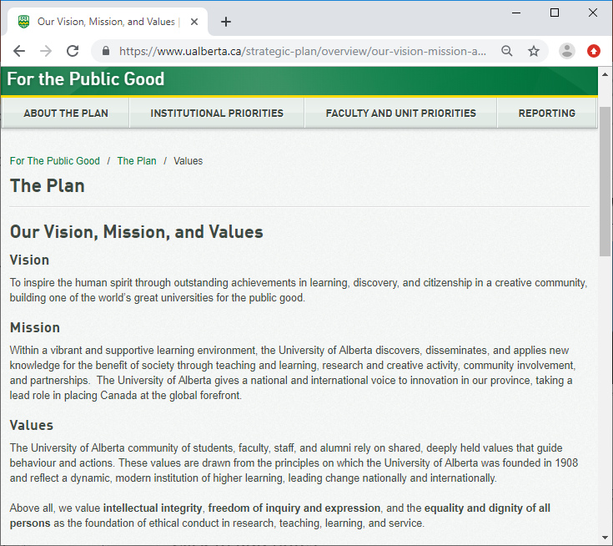
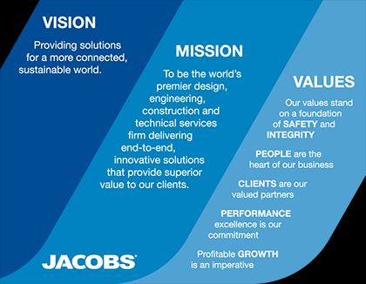
Corporate Mechanisms and Supporting Documents
The University of Alberta:
Jacobs Industrial Services:
http://www.jacobs.com/about#vision-mission-and-values
Chapter 7.5: Organizational Design
5

Slide 6
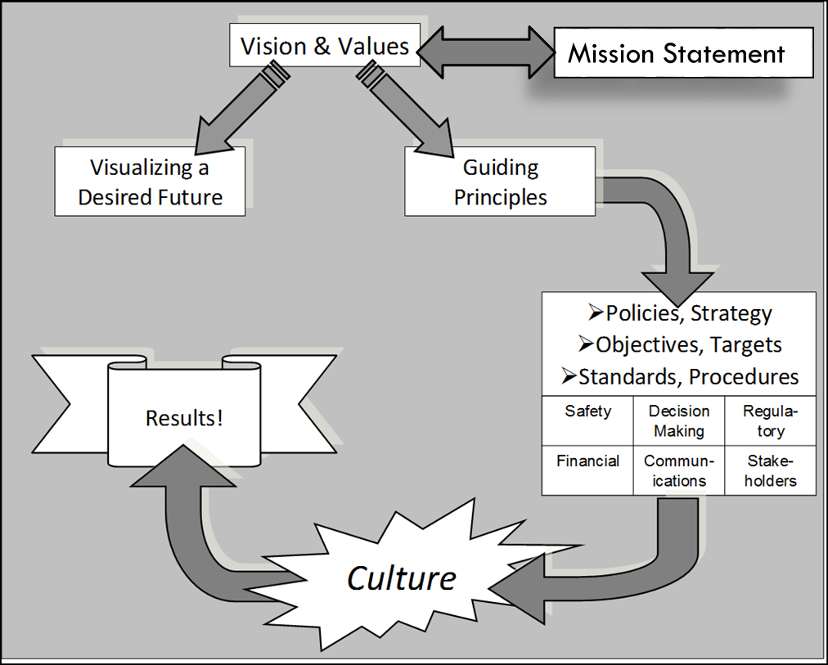
Vision etc. Aligned with Culture?
Think back on your work experience. Did those organizations “live” their corporate statements on vision, mission, values, ethics, corporate responsibility, etc.?
Do they live their values or is it just ‘words on the wall’?
Was the culture aligned with their values?
?
Chapter 7.5: Organizational Design
6

Slide 7

Vision etc. Aligned with Culture?
The culture of the organization (the way we do things) determines bottom-line results.
Chapter 7.5: Organizational Design
7

Slide 8
Supporting Documents:
Documentation (policies, procedures, etc.) establish (set the standard for) and reflect the organization’s culture, and capture their aspirational goals.
Chapter 7.5: Organizational Design
8

Slide 9
The Hierarchy of Documents:
“Administrative Controls” are actually documented procedures that describe the most efficient way to “execute work” at an acceptable level of risk.
Not all documents are created equal!
For example, “Procedures” consist of a wide variety of different mechanisms for guiding work to be safe and efficient.
A set of classifications for procedures:
Life Critical, Life-Saving, Cardinal Rules: e.g. Permit to Work, Hot Work, Isolation and Lock-out, etc.
Critical Procedures
Reference Procedures: e.g. Installation Manual, Operating Manual, Repair Manual
Qualification Training
Critical Practices
General Practices
General Rules and Trades / Crafts Rules
General Training
Chapter 7.5: Organizational Design
9

Slide 10
Corporate Mechanisms and Supporting Documents:
Q: How are the procedures and documents brought to life?
A: Culture i.e. “the way we do work around here.”
Chapter 7.5: Organizational Design
10

Slide 11
The Line Management Model
Every organization is structured like this!
Leaders Exist at All Levels of an Organization
This may be you in the future!
Managers have a large leadership role: they are responsible for those under them
Chapter 7.5: Organizational Design
11

Slide 12
Leaders and Culture within Organizational Design
Q: How do managers and leaders influence culture?
A: Lead by example: “by the way I do work around here.”
Chapter 7.5: Organizational Design
12

Slide 13
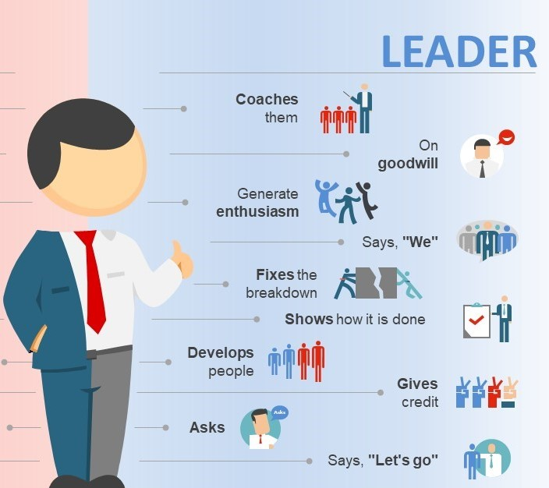
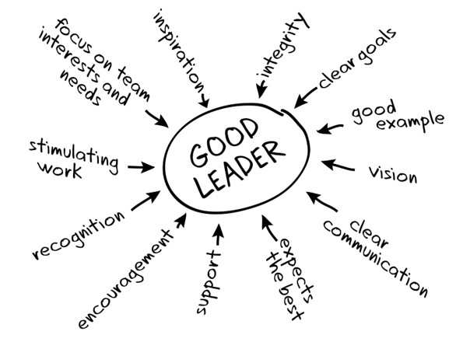
The Characteristics of Good Managers / Leaders:
Graphical models …
Chapter 7.5: Organizational Design
13

Slide 14
The Characteristics of Good Managers / Leaders:
What do you think are some good characteristics?
Sets the expectations for performance.
Checks and follows up that expectations are being met.
Clearly defines responsibilities and holds their people accountable.
Provide the leadership and commitment ... for first-class results.
A working knowledge, be able to critique intelligently ...
Know how to make the best possible use of experts ...
Ensure broad involvement … not just the specialists.
Ensure that a management program is effectively implemented.
Sees the longer-term picture … and integrates continuous improvement in a cost effective way.
Later in this term, we will more closely examine the difference between a manager and a leader.
Chapter 7.5: Organizational Design
14

Slide 15
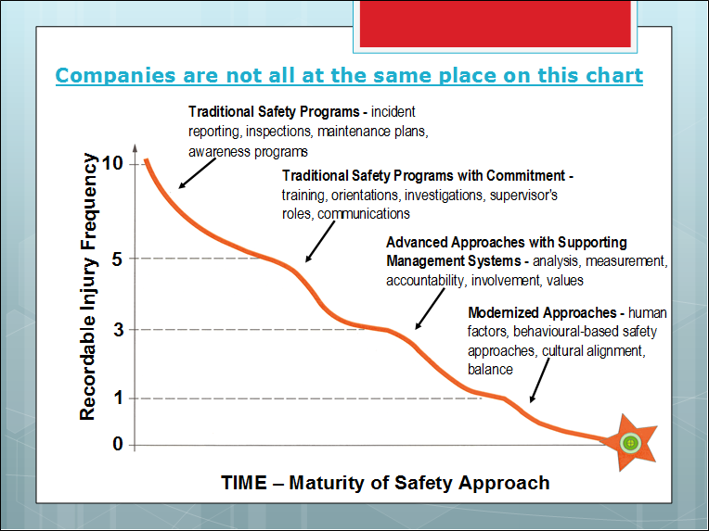

Evolution of Approaches to Safety
Leading organizations clearly see that performance depends on the culture! … and this is where they are putting in the effort …
Modernized Approaches: human factors, behavioral-based safety approaches, cultural alignment, balance, human behaviours
Target: Zero
Chapter 7.5: Organizational Design
15

Slide 16
Summary and Key Lessons:
There is a relationship between “results” and “culture”:
The performance of the organization depends on its culture.
The culture of the organization is influenced (defined, shaped, changed, etc.) by the managers of that organization.
Good Managers / Leaders – their good characteristics – influence the culture in a desirable manner towards desirable results.
Leading organizations believe that the only way to reach “zero incidents” is to actively shape their cultures!
Chapter 7.5: Organizational Design
16

